Slide 1


AR Frameworks
VRA705
By Kessel Okinga Koumou and Mfundo Andrew

Slide 2
Outlines
Background/Introduction
AR Foundation
Activity

Slide 3
Background/Introduction
What is augmented reality (AR)?
AR is a type of immersive technology which enables a user to view computer generated information over the physical world
What are AR frameworks?
Essential supporting structures for AR development across multiple devices.
What are the types of AR implementations?
Marker-based – QR Code
Marker-less – Google Maps (GPS)
Projection-based – Star wars Sci-fi based
Partially/superimposed – Virtually placing an object in the real world

Slide 4
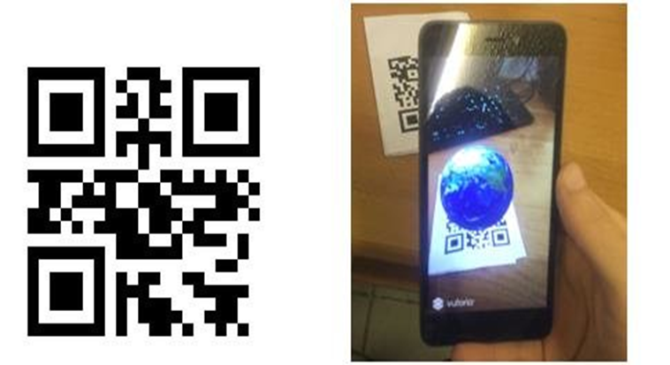
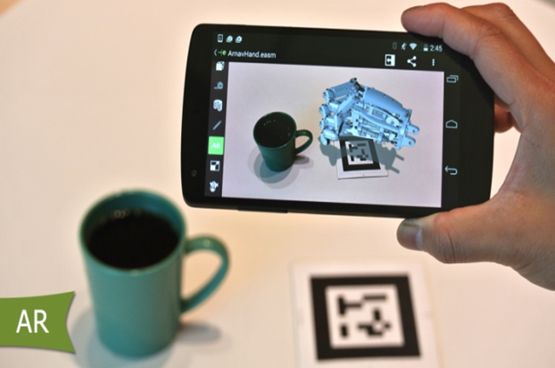
Background/Introduction (cont.)
Marker-based
This type of AR implementation requires an image target to function.

Slide 5
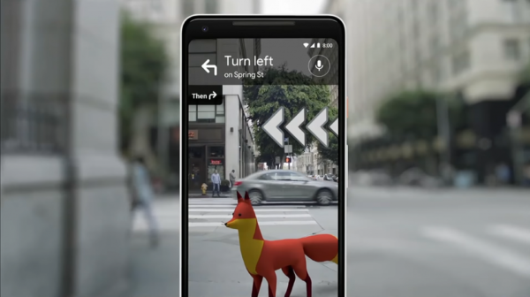
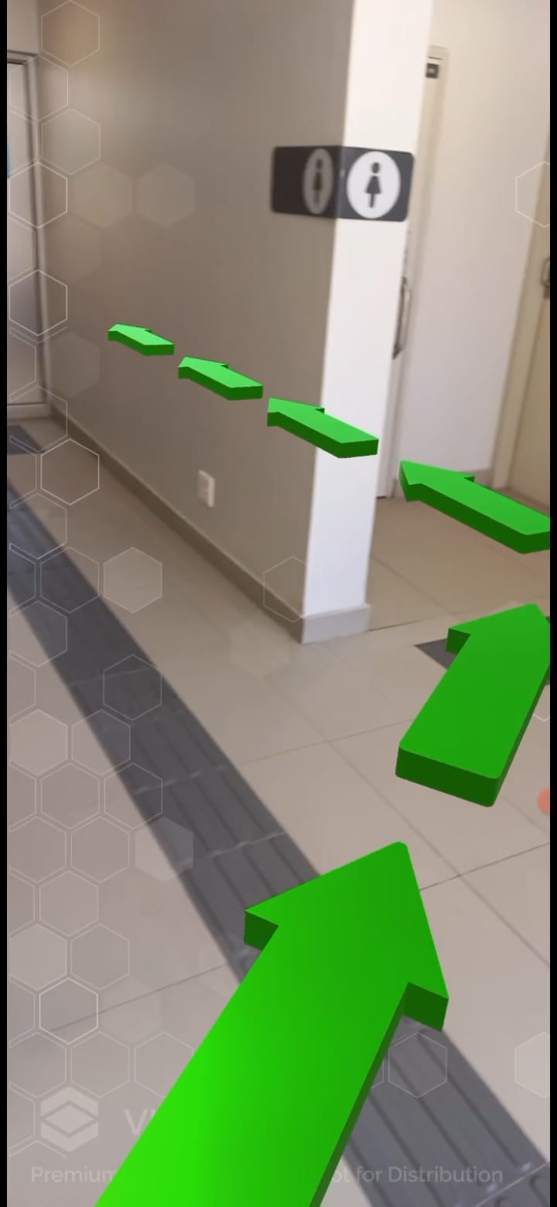
Background/Introduction (cont.)
Marker-less
This type of AR implementation requires external technology such as a global positioning system (GPS) to provide results.

Slide 6
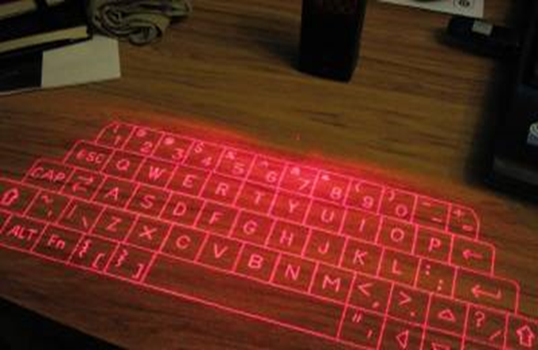
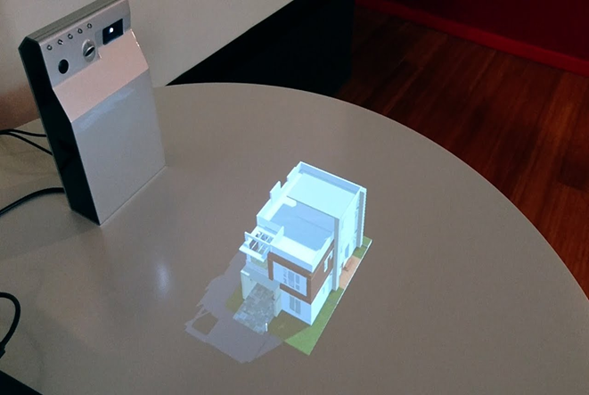
Background/Introduction (cont.)
Projection-based
This type of AR implementation relies on different lighting sources such as lasers to produce a hologram-like output.

Slide 7

Background/Introduction (cont.)
Partially/superimposed
This type of AR implementation only requires flat surfaces to function.

Slide 8
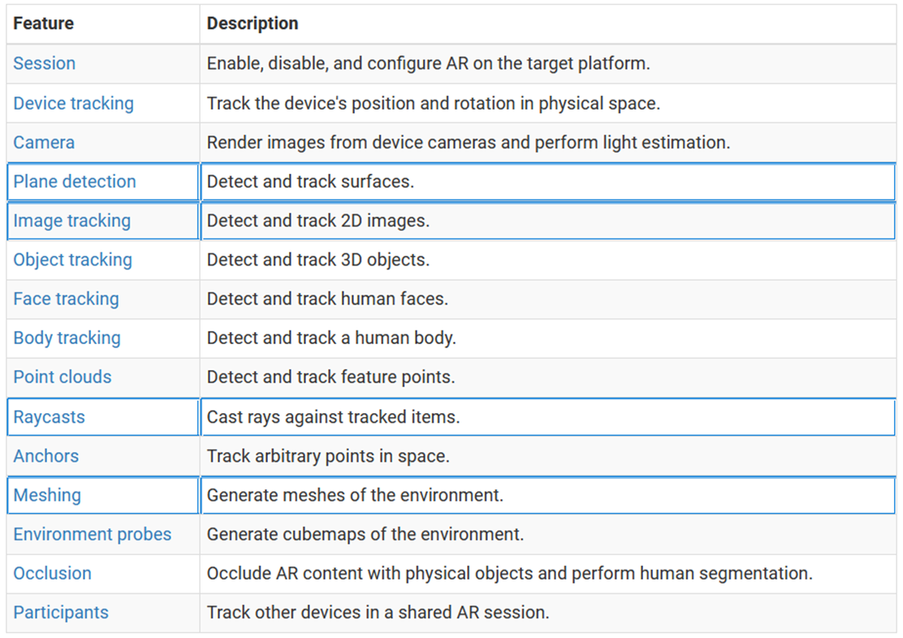
AR Foundation
Overview features support

Slide 9
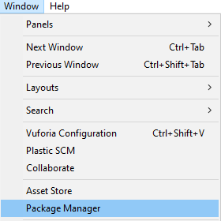
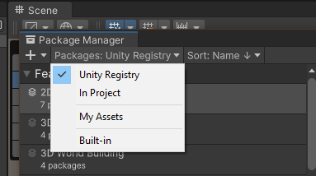
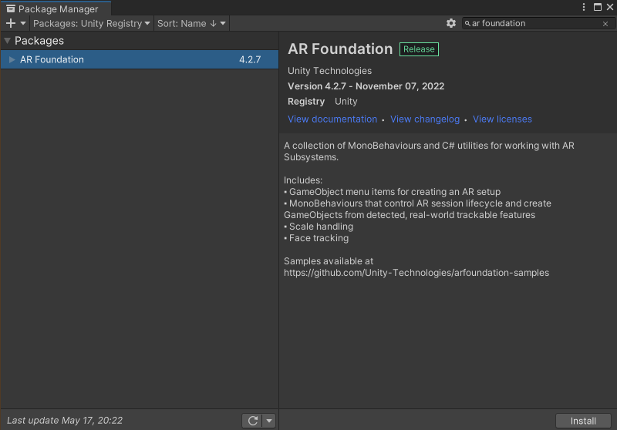
AR Foundation (cont.)
Package installation
Package manager (red highlight)
Select the “Window” tab
Select the “Package Manager” option
Unity Packages (green highlight)
On the top left ensure that “Unity Registry” is selected
Installation (blue highlight)
On the top right search bar type in “AR Foundation”
Select “Install”
Do the same for “ARCore”

Slide 10
AR Foundation (cont.)
AR Session build
AR Session Origin – contains the AR camera manager and AR pose driver
AR Session – contains the AR input manager script
Add the ARRaycastManager and ARPlaneManager scripts to AR Session Origin
Spawn detector
Create an empty GameObject – name it Placement
Create a Quad inside Placement and set the scale to 0.3 across x, y, z
Set the rotation of the Quad to 90, 0, 0,
Create a new material and attach it to the quad
Set the material to Unlit -> transparent
Spawn AR target
Create an empty GameObject – name it Controller
Within Controller create a script named ARPlacement
Placement
Drag and drop your PlacementIndicator GameObject into the Controller
For the AR object any 3D asset can be utilized
Download and import any 3D asset and place it in the controller
Build and Run
Save your work and build an .apk to a mobile device

Slide 11
Activity
Create a new unity build
Title – AR movement
Platform – Android
Auto Graphics API- Set to uncheck
Graphics API – Set to OpenGLES3
Minimum API Level – Set to Android 10 (API 29)
Scripting Backend – Set to IL2CPP
Target Architectures – Set to ARMv7 and ARM64
XR Plug-in Management – Select ARCore
Packages
Lean touch
ARFoundation
ARCore
Hierarchy
Right click on lean then select touch
3D asset Prefab
Add lean pinch scale
Add lean drag translate
Add lean twist axis
Ensure prefab size scaled to 0.3 across x, y, z
Build and Run
Save your work and build an .apk to a mobile device
Zip project and upload on iKamva with .apk build – Later an upload folder will be created

Slide 12
Activity
Create a new unity build using 2 scenes
Title – AR movement
Platform – Android
Auto Graphics API- Set to uncheck
Graphics API – Set to OpenGLES3
Minimum API Level – Set to Android 10 (API 29)
Scripting Backend – Set to IL2CPP
Target Architectures – Set to ARMv7 and ARM64
XR Plug-in Management – Select ARCore
Ensure you have a main scene which can capture user data such as the name and surname
Packages
Lean touch
ARFoundation
ARCore
Hierarchy
Right click on lean then select touch
Canvas asset Prefab*
Add lean pinch scale
Add lean drag translate
Add lean twist axis
Ensure prefab size scaled to 0.3 across x, y, z
Set to world space
Display the stored name and surname
Build and Run
Save your work and build an .apk to a mobile device

